Slide 1

A
PROJECT REPORT
ON
LINE FOLLOWER ROBOT
SUBMITTED BY GUIDED BY
Aditya Channe Mr. Nitin Kaul
B.Tech (ELECTRONICS AND COMPUTER)
1st Semester
SCHOOL OF ELECTRONICS AND ELECTRICAL ENGINEERING
LOVELY PROFESSIONAL UNIVERSITY,
PUNJAB

Slide 2

Lovely Professional University
Jalandhar, Punjab
CERTIFICATE
I hereby certify that the project entitled “LINE FOLLOWER ROBOT” which is being presented in partial requirement for the award of degree of Bachelor of technology and submitted in Department of Electronics and Electrical Engineering, Lovely Professional University, Punjab is an authentic record of my own work carried out during first semester under the supervision of Mr. Nitin Kaul, Department of Electronics and Electrical Engineering, Lovely Professional University, Punjab.
The matter presented in this dissertation has not been submitted by me anywhere for the award of any other degree or to any other institute.
STUDENT GUIDE
Aditya channe Mr. Nitin Kaul
01

Slide 3
ACKNOWLEDGEMENT
It has come out to be a sort of great pleasure and experience for me to work on the project line follower robot(LFR). I wish to express my indebtedness to those who helped me i.e. the faculty of our Institute Mr. Nitin Kaul sir during the preparation of the this project. This would not have been made successful without his help and precious suggestions. Finally, I also warmly thanks to all my friends and family who encouraged me to an extend, which made the project successful.
02

Slide 4
CONTENTS
1.Introduction……………………………………………………………………03
2.Components……………………………………………………………………04
3.Block Diagram…………………………………………………………………09
4. Circuit Diagram………………………………………………………………12
5. Working Principle…………………………………………………………..13
6.Advantages…………………………………………………………………….14
7. Disadvantages………………………………………………………………..14
8.Applications……………………………………………………………………15
9.Conclusion………………………………………………….………………….15
10.Futurescope………………………………………………………………….15
11.Bibliography………………………………………………………………….16

Slide 5
INTRODUCTION
A line follower robot is basically a robot designed to follow a ‘line’ or path already predetermined by the user. This line or path may be as simple as a physical white or black line on the floor or as complex path making schemes e.g. embedded lines, magnetic markers and laser guide markers. In order to detect these specific markers or ‘lines’, various sensing schemes can be employed. These schemes may vary from simple low cost line sensing circuit to expensive vision system. The choice of these schemes would be dependent upon the sensing accuracy and flexibility required. From the industrial point of view, line following robot has been implemented in semi to fully autonomous plants. In this environment, these robots functions as material carrier to deliver product from one manufacturing point to another where rail, conveyor and gentry solutions are not possible. Apart from line following capabilities, these robots should also have the capability to navigate junctions and decide on which junction to turn and which junction ignore. This would require the robot to have 90 degree turn and also junction counting capabilities. To add on the complexity of the problem, sensor positioning also plays a role in optimizing the robots performance for the tasks mentioned earlier.
Line-following robots with place and placement capabilities are commonly used in manufacturing plants. These move on a specified path to pick the components from specified locations and place them on desired locations. Basically, a line-following robot is a self-operating robot that detects and follow a line drawn on the floor. The path to be taken is indicated by a black line on white surface. The control system used must sense the line and man oeuvre the robot stay on course while constantly correcting the wrong moves using feedback mechanism, thus forming a simple yet effective closed-loop system.
03

Slide 6
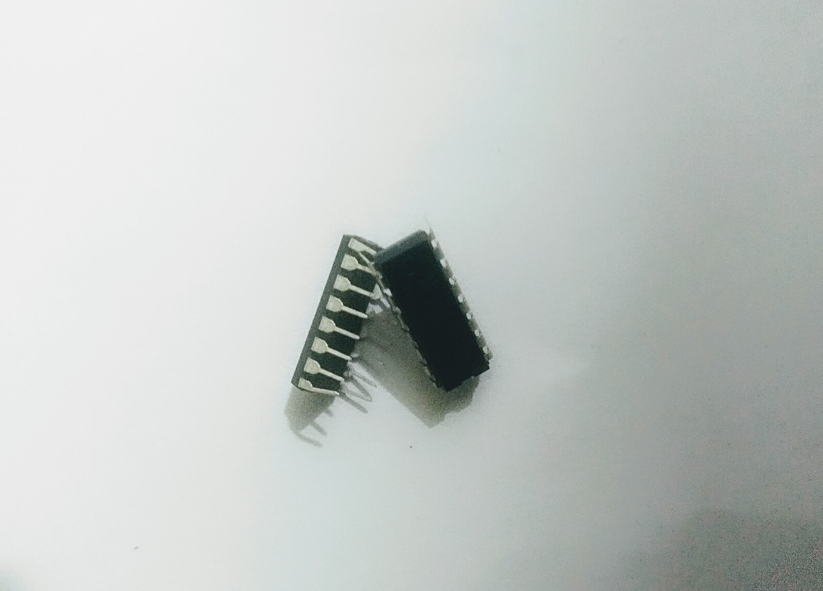
COMPONENTS
The components used for making this Line following robot are:-
L293D (MOTOR DRIVER)
Fig 1
L293D is a typical Motor driver or Motor Driver IC which allows DC motor to drive on either direction. L293D is a 16-pin IC which can control a set of two DC motors simultaneously in any direction. It means that you can control two DC motor with a single L293D IC.
04

Slide 7
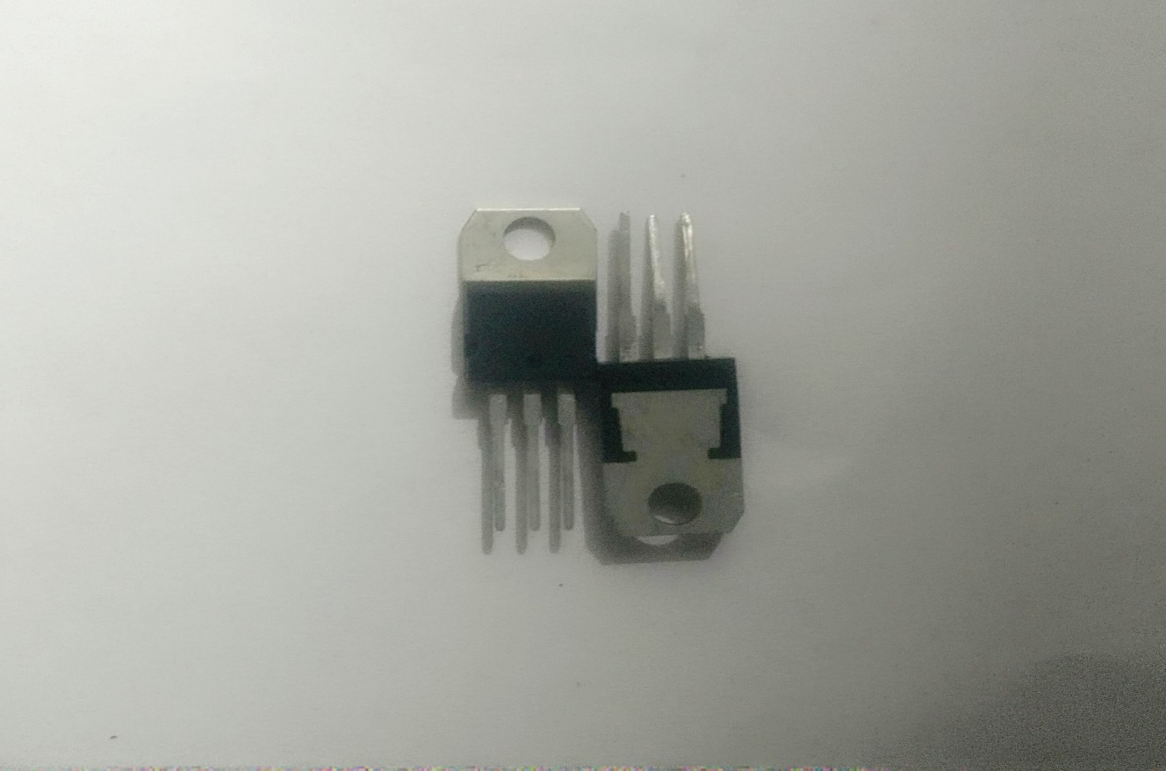
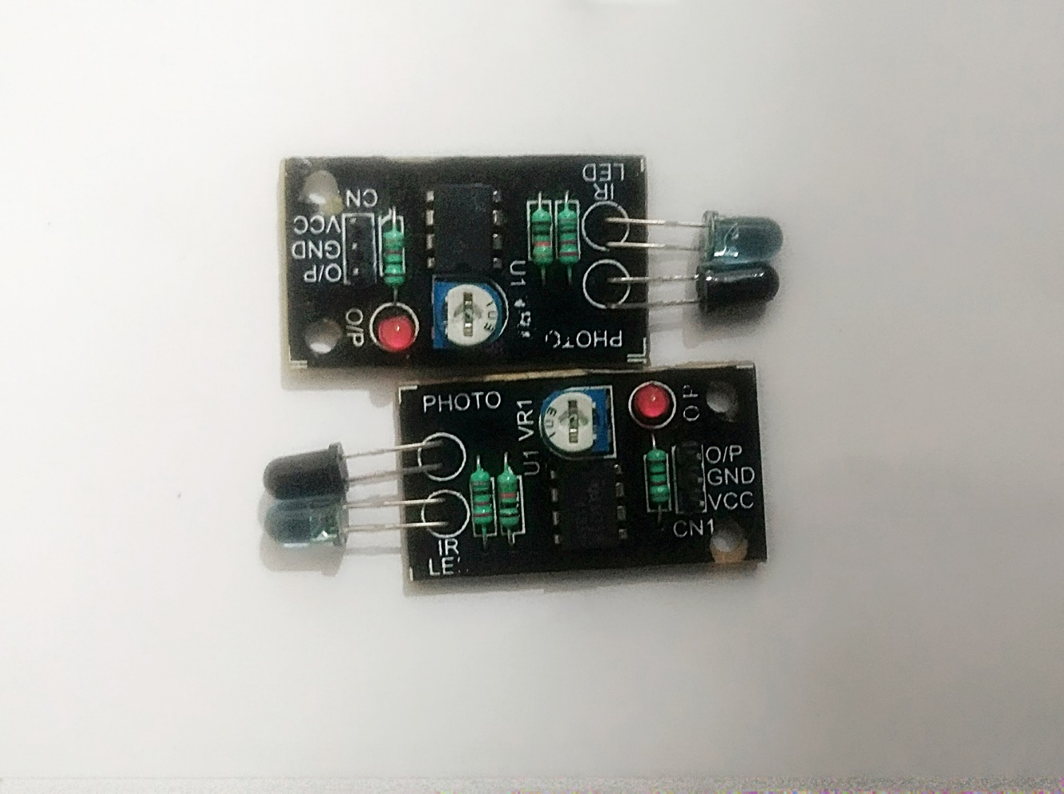
IC7805(VOLTAGE REGULATOR)
Fig 2
IC 7805 is a 5V Voltage Regulator that restricts the voltage output to 5V and draws 5V regulated power supply. It comes with provision to add heat sink.
IR SENSOR
Fig 3
A passive infrared sensor (PIR sensor) is an electronic sensor that measures infrared (IR) light radiating from objects in its field of view. They are most often used in PIR-based motion detectors.
05

Slide 8
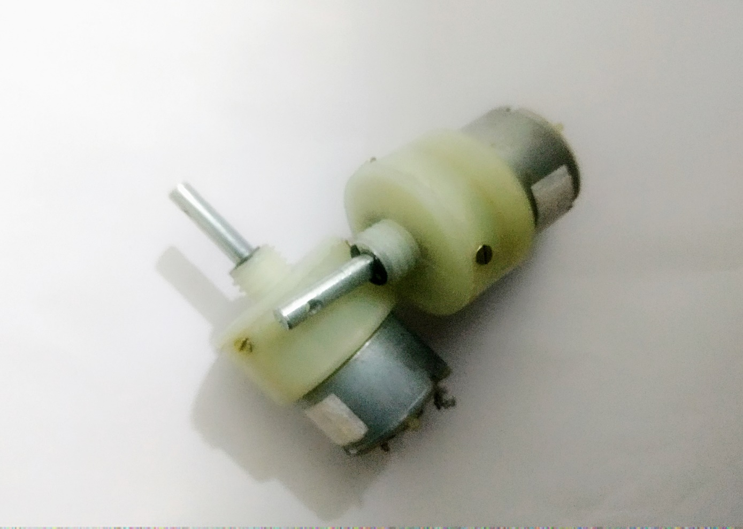
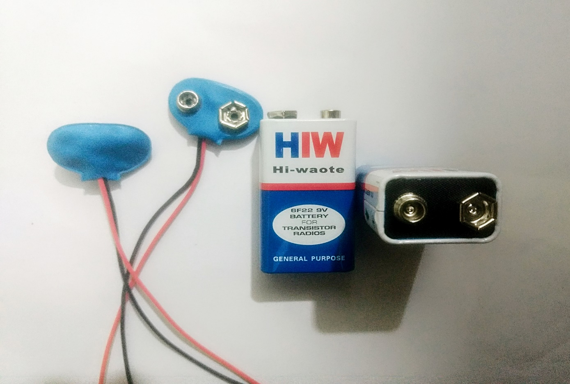
DC MOTOR
Fig 4
A DC motor is any of a class of electrical machines that converts direct current electrical power into mechanical power. The most common types rely on the forces produced by magnetic fields.
BATTERY (9 V)
Fig 5
A battery is an electrochemical cell(or enclosed and protected material) that can be charged electrically to provide a static potential for power or released electrical charge when needed
06

Slide 9
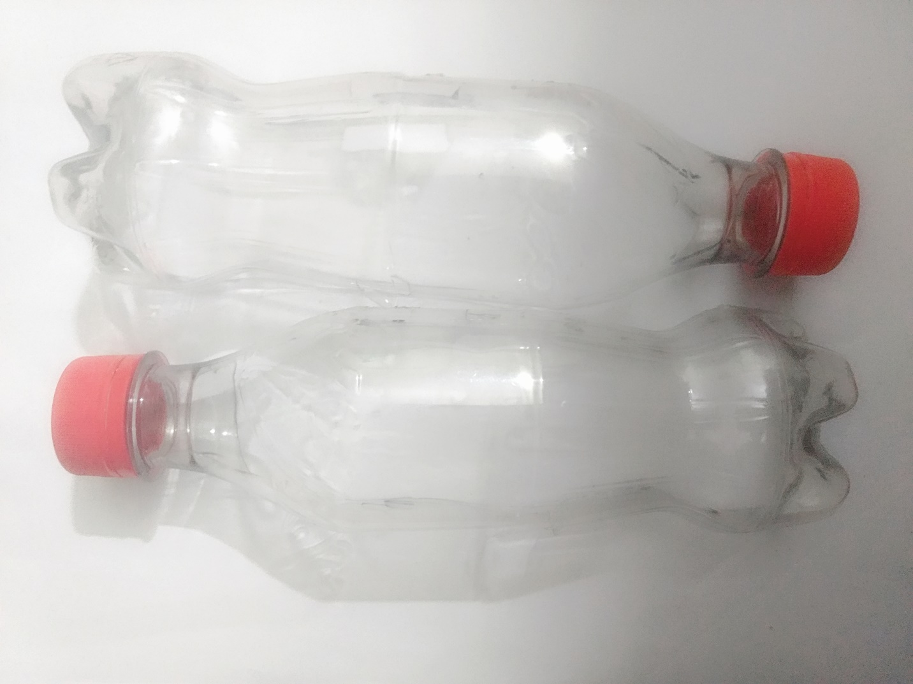
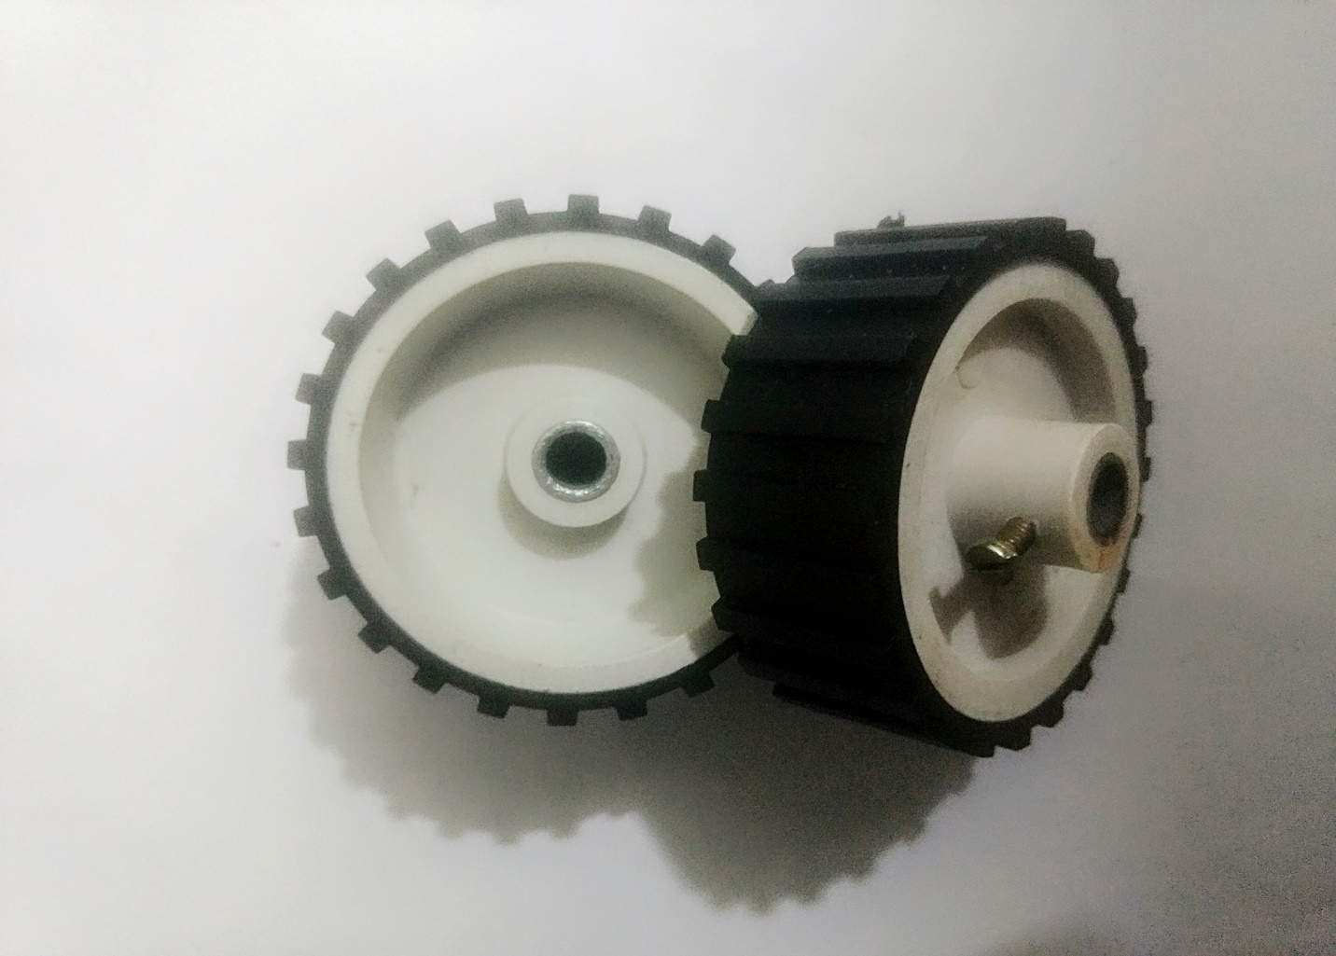
CHASSIS
Fig 6
A chassis is the physical frame or structure of an automobile, an airplane, a desktop computer, or other multi-component device
WHEEL
Fig 7
a circular object that revolves on an axle and is fixed below a vehicle or other object to enable it to move easily over the ground.
07

Slide 10
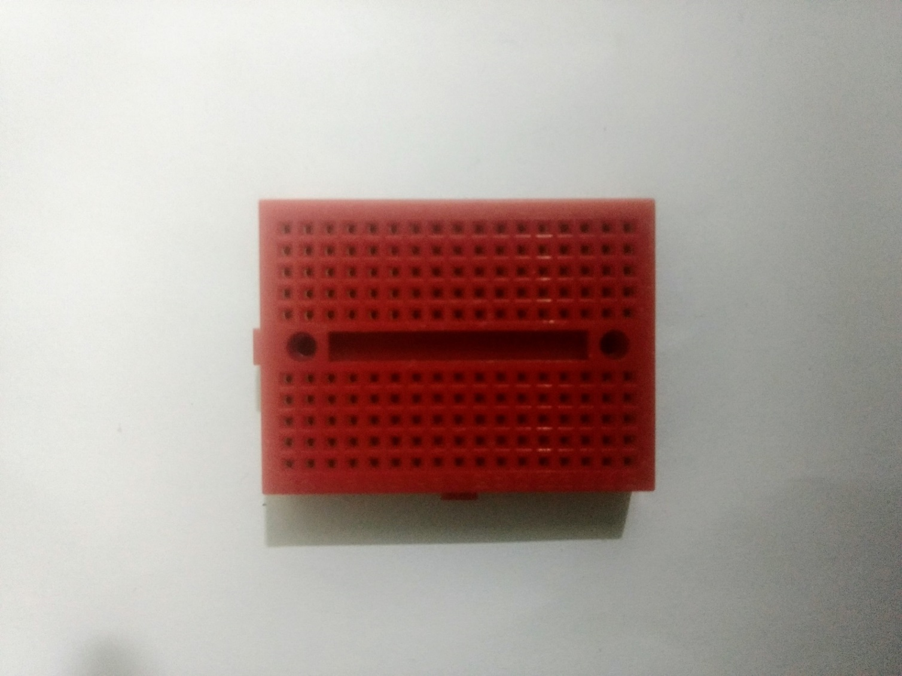
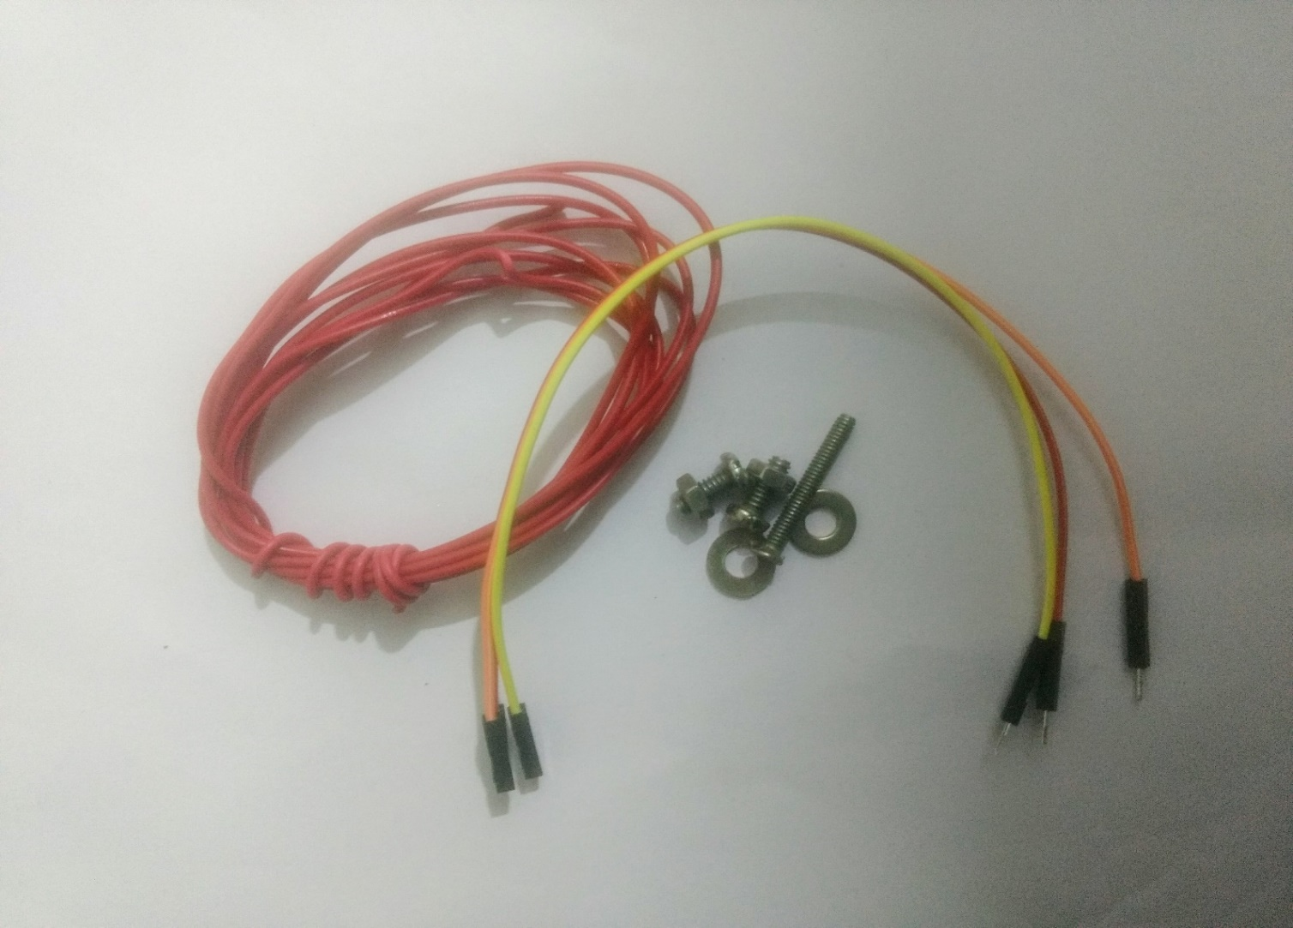
BREAD BOARD
Fig 9
A breadboard also known as protoboard is a type of solderless electronic circuit building. You can build a electronic circuit on a breadboard without any soldering ! Best of all it is reusable. It was designed by Ronald J Portugal of EI Instruments Inc. in 1971.
CONNECTING WIRES, JUMPING WIRES, NUTS and BOLTS
Fig 10
08

Slide 11
BLOCK DIAGRAM
L293D (MOTOR DRIVER)
ENABLE 1,2
VCC 1
INPUT 1
OUTPUT 4
OUTPUT 1
INPUT 4
GND
L293D
GND
GND
GND
INPUT 2
OUTPUT 3
OUTPUT 2
INPUT 3
VCC 2
ENABLE 3,4
Fig 11
09

Slide 12
IC7805
IC7805
INP UT
OUTPUT
GND
Fig 12
IR SENSOR
OUTPUT
IR SENSOR
GND
VCC
Fig 13
10

Slide 13
TRACK
IR SENSOR
MOTOR DRIVING CIRCUIT
MOTOR
11

Slide 14
CIRCUIT DIAGRAM
IR SENSOR
IR SENSOR
1
2
3
4
5
6
7
8
16
15
14
13
12
11
10
9
GND
GND
+
-
+
-
IC7805
1 2 3
GND
GND
GND
GND
GND
12

Slide 15
WORKING PRINCIPLE
When a sensor is on the black line it reads 0 and when it is on the bright surface it reads 1.
LEFT TURN
When left sensor senses the black line then the left motor stops while the right motor continue to move so that left turn takes place and robot returns on white side.
RIGHT TURN
When right sensor senses the black line then the right motor stops while the left motor continue to move so that right turn takes place and robot returns on white side.
STOPPING
When both the sensors senses black light both the motor stops moving and the robot stops
13

Slide 16
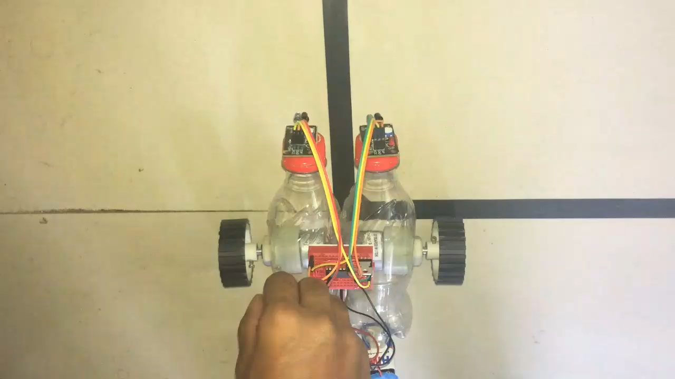
video

Slide 17
ADVANTAGES
Robot movement is automatic
Fit and Forget system
Used for long distance applications
Defense applications
Used in home, industrial automation.
Cost effective
Simplicity of building
DISADVANTAGES
LFR follows a black line 1 or 2 inches in width on a white surface.
LFR are simple robots with an additional sensors placed in them
Needs a path to run either white or black since the IR rays should reflect from the particular path.
Slow speed and instability on different line thickness or hard angles
14

Slide 18
APPLICATIONS
Guidance system for industrial robots moving on shop floor etc.
Industrial applications
Home applications
Healthcare applications
CONCLUSION
In this project we have studied and implemented a Line Following Robot.
FUTURE SCOPE
Smarted versions of line followers are used to deliver mails within office buildings and deliver medications in a hospital
This technology has been suggested for running buses and other mass transmit system and may end up as a part of autonomous cars navigation the freeway
15

Slide 19
BIBLIOGRAPHY
www.google.com
www.youtube.com
Nitin Kaul sir
www.robotshop.com
www.makerbot.com
16

